Slide 1



X
Create Data Warehouse and ETL for ID/X Partners client data
ID/X Partners - Data Engineer
Presented by
Muhammad Reesa Rosyid

Slide 2





Muhammad Reesa Rosyid
Machine Learning Research Assistant
Aspiring computer science professional with a robust foundation in machine learning, quantum computing, and data-driven research, complemented by hands-on experience in developing innovative solutions for real-world problems. Passionate about harnessing cutting-edge technologies to address complex challenges, from AI-driven healthcare innovations to sustainable environmental management systems. Eager to contribute to collaborative, forward-thinking projects that push the boundaries of technological advancements and create meaningful impacts in both academic and industrial domains.
Semarang
mreesa669@gmail.com
https://www.linkedin.com/in/mreesarosyid/

Slide 3
Project Portfolio
One of ID/X Partners' banking industry clients faces challenges in processing data from multiple sources, including Excel files, CSV files, and SQL Server databases. Difficulties in extracting and integrating this data have led to delays in reporting and business analysis.
To address this issue, a Data Warehouse (DWH) solution is required to consolidate data from various sources into a centralized system. The ETL (Extract, Transform, Load) process must be optimized to ensure efficient and structured data migration into the DWH. Additionally, a mechanism is needed to prevent duplicate transaction data and create Stored Procedures that can quickly generate data summaries.
By implementing this solution, the company can enhance data processing efficiency and accelerate data-driven decision-making.
Project explanation video here!

Slide 4






Tools

Slide 5
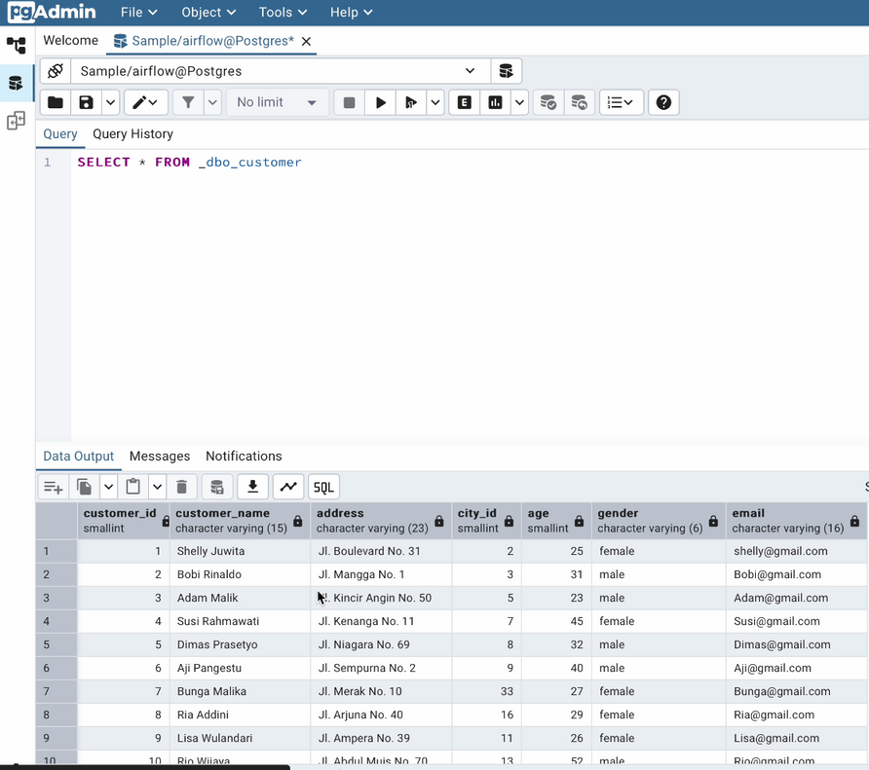
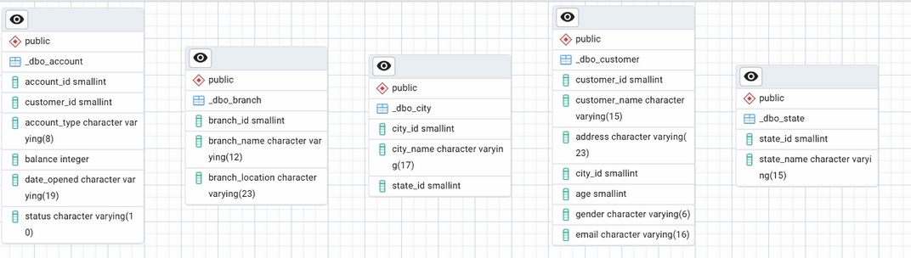
Restore Database

Slide 6
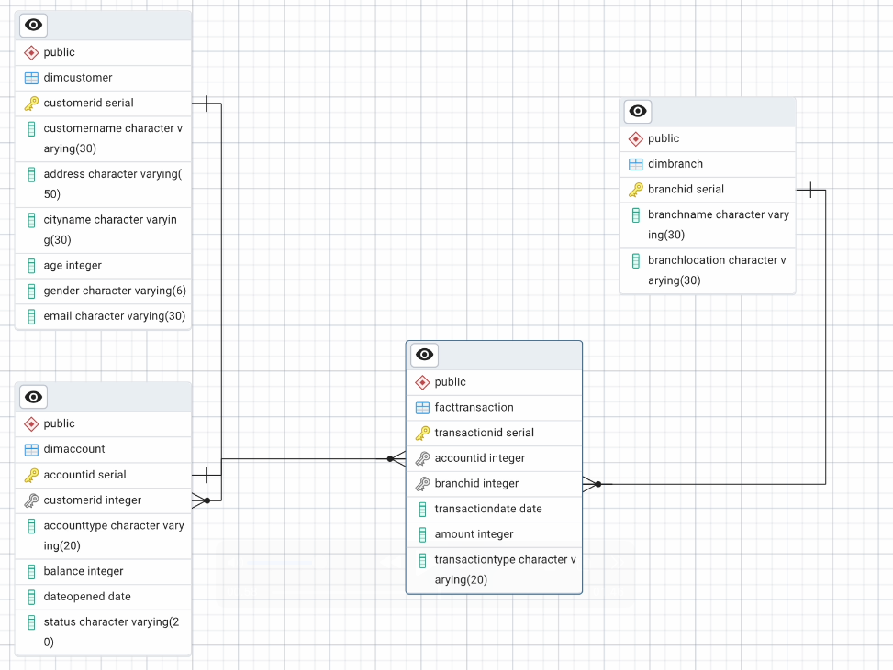
Create DWH for Data Warehouse

Slide 7
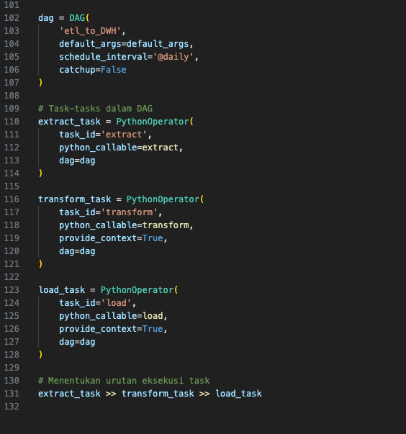
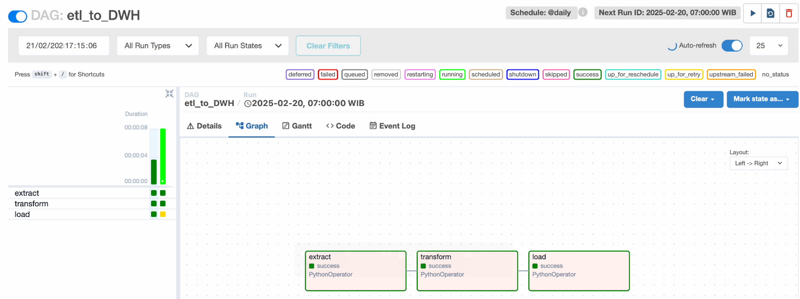
Create ETL Job

Slide 8
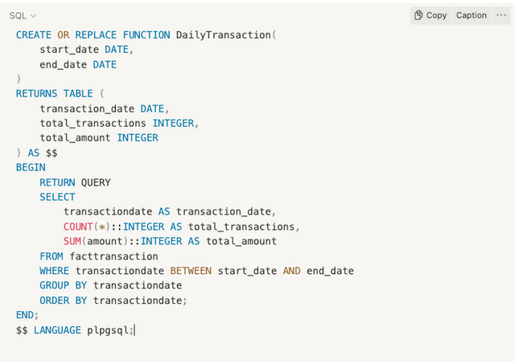
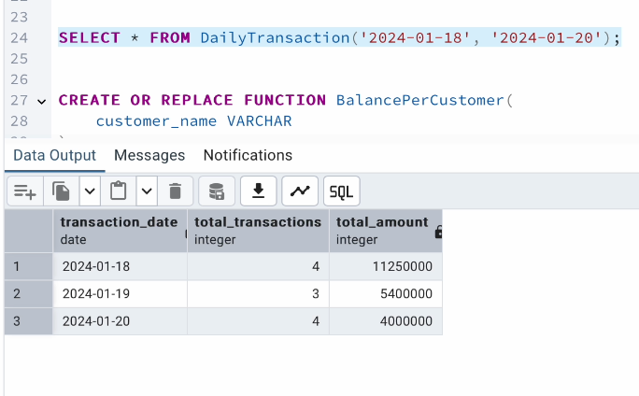
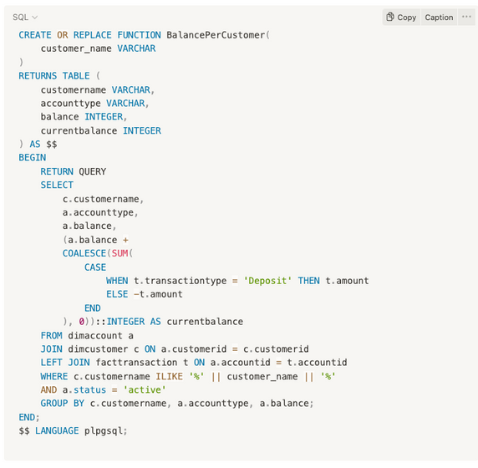
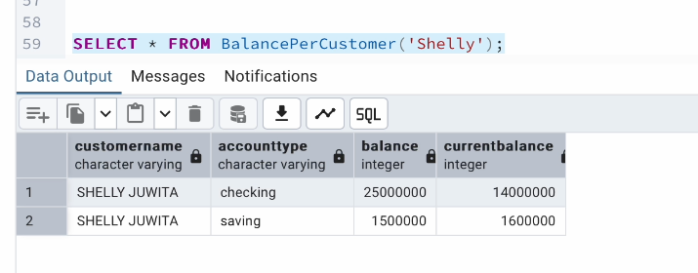
Create Stored Procedure

Slide 9

Thank You
X

